Slide 1

Product Analysis and Customer Lifetime Value
Group 7 Section 003
Aashutosh Sehgal – 0780170
Dattu Reddy Pedholla – 0782042
Devashish Patel – 0781214
Rachna Rachna – 0782821
Rohit Rohit - 0773987

Slide 2
Overview of Problem
The objective of this project is to analyse the product and customer lifetime value. We will also determine and predict the further 3 month period lifetime value using the machine learning models based on the data we already have.

Slide 3
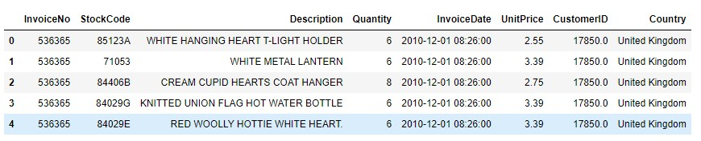
Review of Data Source
The dataset named online retail contains of 541909 rows and 8 columns. Each row represents an invoice generated while the 8 columns represent the number for that stock, product description and certain customer details etc.
The columns are defined as follows:
Invoice number - Identity number that is generated for a specific order.
Stock Code – Number used identify a product.
Description – Description of product.
Quantity – Number of units sold.
Customer ID – Unique ID for each customer.
Unit price – Price for each of the product mentioned.
Invoice Date – Date at which the invoice was generated.
Country – Country at which the invoice was generated.

Slide 4

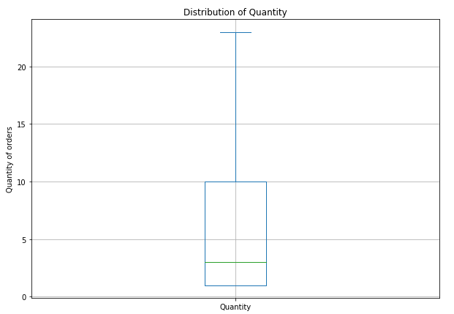
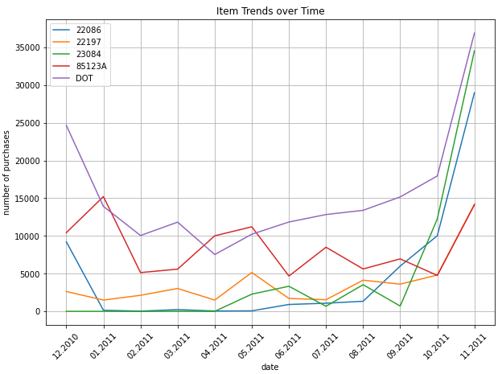
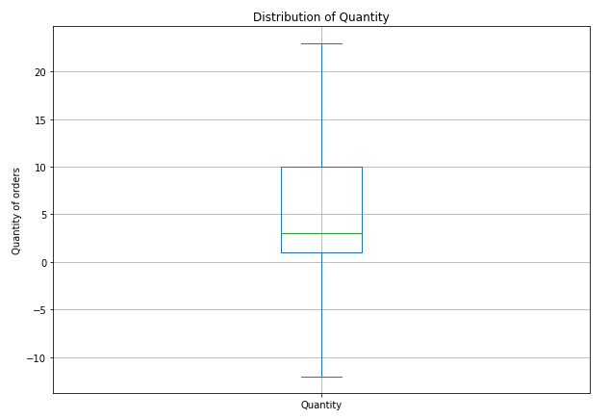
After a preliminary look at the data, we notice that there are negative values in quantity column. To remove this outlier, we will remove all the negative values.

Slide 5

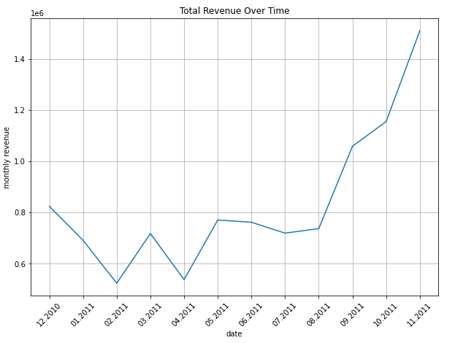
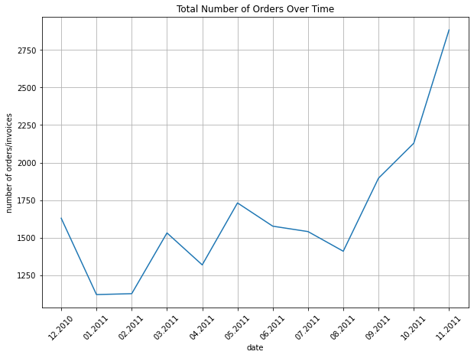
Descriptive Insights
In the following charts, we can see the trends over time of number of purchases as well as the revenue over the given time period.
As we can see, the total number of orders over time is fluctuated all the way to November 2011, but at the end of the year both the revenue as well as the number of orders was the highest in the year.

Slide 6
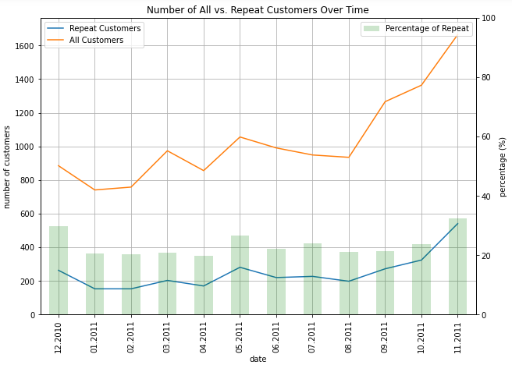
For the following chart, we can see the comparison between the number of total customers vs the repeat customers over the given time period.
As we can see, both fluctuated all throughout the given time period, but both were highest at the end of the year.
On the other hand, the bars in green show us the percentage of repeat customers out of the total customers.

Slide 7
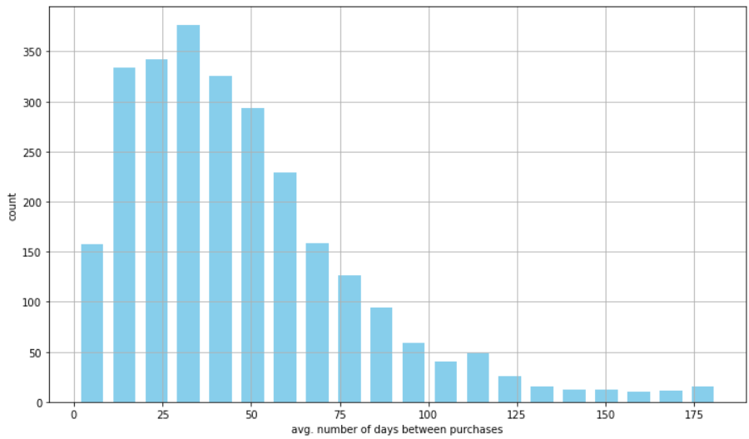
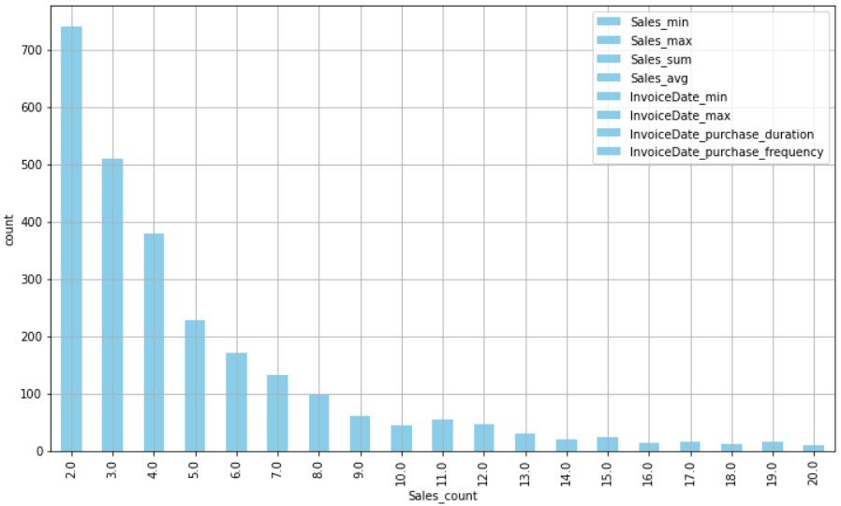
ANALYSIS OF Recency frequency AND TOTAL AMOUNT SPENT BY CUSTOMERS
In the chart on the right, we can see the average number of days passed between purchases. We can see that majority of the gaps between purchases in average number of days is relatively lower between 20 to 60 days, and very few purchases have a gap of more than 100 days.
In the chart on the left, we can see the sales count of repeat customers. We can see that majority of the sales count lies between 2 to 7 purchases and it decreases gradually as the count increases although there are some exceptions to this phenomenon.

Slide 8
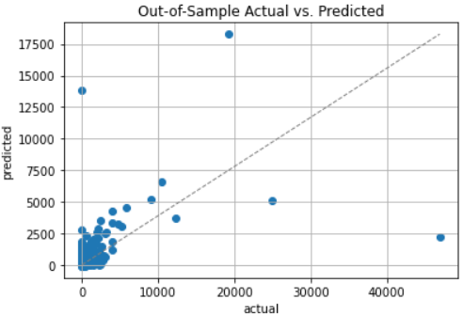
Predicting 3-month customer lifetime value (CLV) and model interpretation
For predicting the customer lifetime value (CLV), we broke down the data into chunks of 3 months and then predicted the sales for 3 months based on this change.
We created a linear regression model for predicting CLV.
In the graph on the right, we can see the model’s actual vs predicted phenomenon. As we can see most of the data points are aggregated close to the linear regression line. This means that the CLV is high for these customers.

Slide 9
Future recommendations/PROPOSAL
From the product analysis we can see the demand of particular products and the ones generating highest revenue.
The best-performing items in terms of number of purchases in the specified time period were DOT and 23084. This means that the marketing strategies used for these items could be tried for other items in order to increase the revenue generated by them.
Product number 84826 generated no revenue at all in the given time period and should be shelved unless it is revamped with either product changes to increase customer satisfaction.
From the Customer Analytics, we observed which customers belong to the repeat and non-repeat categories, as well as which customers helped in generating more revenue.
At the same time, we observed which customers are the most profitable by performing RFM analysis in terms of repeat purchases and repeat items.

Slide 10
THANK YOU

